Slide 1
Object Oriented Programming using Java
(24BEDAS303)
Dr.Chaithra
Professor
Department of CSE-AIML
SNPSU

Slide 2
Prerequisite
To learn Java, you must have the basic knowledge of C/C++ programming language.

Slide 3
Module 1
Introduction to Java: Features of Java, Java Virtual Machine (JVM), Compiling and running a Java program.
Data Types, Operators, and Control Structures: Primitive and Non-Primitive Data Types, Variables , Arrays, Operators in Java, Control Structures recap.
Introducing Classes: Class and Object, Class Fundamentals, Methods, Constructors and its Types, Static vs. Non-static Members, The ‘this’ keyword.
Ch: 2,3,4,5,6

Slide 4
Introduction to Java
Java is a most popular, object-oriented, widely used programming language and platform that is utilized for Android development, web development, artificial intelligence, cloud applications, and much more.
So, mastering this gives you great opportunities in bigger organizations.

Slide 5
History
Java was developed by Sun Microsystems in the year 1995.
Java is now the owned and controlled by Oracle.
James Gosling is known as the father of Java.
Before Java, its name was Oak. Since Oak was already a registered company, so James Gosling and his team changed the Oak name to Java.

Slide 6
Object-Oriented Programming
Object oriented programming (OOP) is the core of Java programming.
Java is a general purpose, object- oriented programming language developed by Sun Microsystems. It was invented by James Gosling and his team and was initially called as Oak.
The most important feature that made Java very popular was the ―Platform- Independent approach.
It was the first programming language that did not tie-up with any particular operating system( or hardware) rather Java programs can be executed anywhere and on any system.
Java was designed for the development of the software for consumer electronic devices like TVs, VCRs, etc.

Slide 7
Two Paradigms of Programming
Process-Oriented Programming (POP)
Object-Oriented Programming (OOP)

Slide 8
Process-Oriented Programming (POP)
Focus: POP focuses on the processes or functions that manipulate data. The emphasis is on procedures or routines that perform specific tasks.
Data Handling: Data and functions are separate entities. Data is often global and can be accessed by any function.
Top-Down Approach: Programs are typically designed using a top-down approach, breaking down the problem into smaller tasks and procedures.
Example: Traditional procedural languages like C are process-oriented. In C, you write functions that operate on data, and the flow of the program is directed by function calls.

Slide 9
Object-Oriented Programming (OOP)
Focus: OOP focuses on modeling real-world entities as objects that have both data (attributes) and behaviors (methods).
Data Encapsulation: Data and methods are encapsulated together into objects. Objects interact with each other through well-defined interfaces.
Abstraction and Inheritance: OOP supports concepts like abstraction, allowing you to hide complex implementation details, and inheritance, enabling you to create new classes based on existing ones.
Example: Java, Python, and C++ are examples of object-oriented languages. In Java, for instance, you define classes representing objects, and these classes encapsulate both data (attributes) and methods (behaviors).

Slide 10
Abstraction
Abstraction is a fundamental concept in computer science and Object-Oriented Programming (OOP) that involves simplifying complex systems by modeling classes based on the essential properties and behaviors they share.
Abstraction allows you to focus on the essential characteristics of an object while ignoring the unnecessary details.
Let's consider a real-world example to illustrate abstraction: a TV remote control.

Slide 11
The Three OOP Principles
Encapsulation
Inheritance
Polymorphism

Slide 12
The Three OOP Principles
Encapsulation:
Encapsulation is the mechanism that binds together code and data it manipulates, and keeps both safe from outside interference and misuse.
In Java the basis of encapsulation is the class. A class defines the state and behavior( data & code) that will be shared by set of objects.
Each object contains the structure and behavior defined by the class. The data defined by the class are called instance variables(member variables), the code that operates on that data are called methods(member functions)

Slide 13
Inheritance:
Inheritance is the process by which one object acquires the properties of another object. This is important as it supports the concept of hierarchical classification.
By the use of inheritance, a class has to define only those qualities that make it unique. The general qualities can be derived from the parent class or base class.
Ex: A child inheriting properties from parents.

Slide 14
Polymorphism:
Polymorphism (meaning many forms) is a feature that allows one interface to be used for a general class of actions. The specific action determined by the exact nature of the situation. This concept is often expressed as “ one interface, multiple method
Ex: “+” can be used for addition of 2 numbers and also concatenation of 2 strings. System.out.println(2+4); // outputs 6 as answer
System.out.println(“Hello” + “Gautham”); // outputs Hello Gautham as answer Apart from this the additional features include:

Slide 15
Java Platform & the Creation of Java
Any hardware or software environment in which a program runs is known as a platform. Since Java has its own runtime environment (JRE-Java Runtime Environment) and API, it is called platform.
The Java platform has two components – API and Java Virtual Machine
The Java Virtual Machine :
It is an abstract machine and it is the base for the Java platform and is ported onto various hardware- based platforms.
The Java Application Programming Interface (API) :
The API is a large collection of ready-made software components that provide many useful capabilities. It is grouped into libraries of related classes and interfaces; these libraries are known as packages.

Slide 16
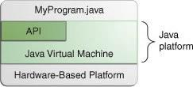
Java was originally developed to develop a language for digital devices such as set-top boxes and consumer electronic devices such as microwave ovens and remote controls.
Java was developed by James Gosling, Patrick Naughton, Mike Sheridan at Sun Microsystems Inc. in 1991. It took 18 months to develop the first working version.
The initial name was Oak but it was renamed to Java in 1995.

Slide 17
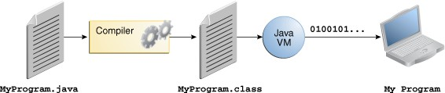
Platform Independence or Architecture Neutral or Portable:
(Write Once, Run Anywhere)
Java is a Platform Independent language. Java sometimes called as “Write Once, Run Anywhere (WORA)” language.
Java achieves platform independence through bytecode and JVM.

Slide 18
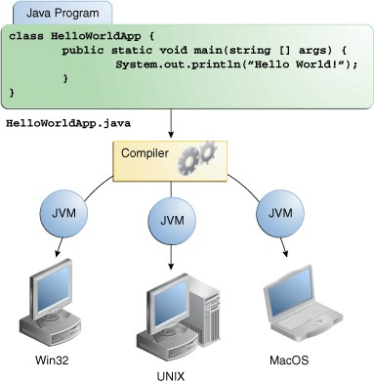
Java Program Execution:
In the Java programming language, all source code is first written in plain text files ending with the .java extension.
Those source files are then compiled into .class files by the javac compiler.
A .class file does not contain code that is native to your processor; it instead contains bytecodes — the machine language of the Java Virtual Machine (Java VM).
The java launcher tool then runs your application with an instance of the Java Virtual Machine.
Through the JVM, the same application is capable of running on multiple platforms.
Java’s magic: bytecode
Bytecode:
Bytecode is a highly optimized set of instructions designed to be executed by the Java run-time system, which is called the Java Virtual Machine (JVM).
Java is platform independent but JVM is platform dependent:
JVM is platform independent because JVM is designed to each platform separately.

Slide 19
Installation of JAVA
JDK(NEW VERSION)
ECLIPSE:
https://youtu.be/Cf2TFrZW2l0?si=CGRAVfCUK0YeYcMn

Slide 20
A First Simple Program
class Example
{
public static void main(String args[])
{
System.out.println(“Welcome to Programming in Java”);
}
} Output of the program: Welcome to Programming in Java
1. Open the notepad and type the above program
2. Save the above program with .java extension, here file name and class name should be
same, ex: Example.java
3. Open the command prompt and Compile the above program javac Example.java
From the above compilation the java compiler produces a bytecode(.class file)
4. Finally run the program through the interpreter java Example.java

Slide 21
Description:
Class declaration: ―class Example‖ declares a class, which is an object- oriented construct. Sample one is a Java identifier that specifies the name of the class to be defined.
Opening braces: Every class definition of Java starts with opening braces and ends with matching one.
The main line: the line ― public static void main(String args[]) ― defines a method name main. Java application program must include this main. This is the starting point of the interpreter from where it starts executing. A Java program can have any number of classes but only one class will have the main method.
Public: This key word is an access specifier that declares the main method as unprotected and therefore making it accessible to the all other classes.
Static: Static keyword defines the method as one that belongs to the entire class and not for a particular object of the class. The main must always be declared as static.
Void: the type modifier void specifies that the method main does not return any value.
The println: It is a method of the object out of system class. It is similar to the printf or cout of c or c++. This always appends a newline character to the end of the string i.e, any subsequent output will start on a new line.

Slide 22
A Second Short Program
/*
Here is another short example.
Call this file "Example2.java".
*/
class Example2 {
public static void main(String args []) {
int num; // this declares a variable called num
num = 100; // this assigns num the value 100
System.out.println("This is num: " + num);
num = num * 2;
System.out.print("The value of num * 2 is ");
System.out.println(num);
}
}

Slide 23
Data Types, Variables, and Arrays
Java Is a Strongly Typed Language
It is important to state at the outset that Java is a strongly typed language. Indeed, part of Java’s safety and robustness comes from this fact.
First, every variable has a type, every expression has a type, and every type is strictly defined.
Second, all assignments, whether explicit or via parameter passing in method calls, are checked for type compatibility.
There are no automatic coercions or conversions of conflicting types as in some languages.
The Java compiler checks all expressions and parameters to ensure that the types are compatible. Any type mismatches are errors that must be corrected before the compiler will finish compiling the class.

Slide 25
The Primitive Types
Java defines eight primitive types of data:
byte, short, int, long, char, float, double, and boolean.
The primitive types are also commonly referred to as simple types.
These are grouped into 4 groups:
• Integers This group includes byte, short, int, and long, which are for whole-valued signed numbers.
• Floating-point numbers This group includes float and double, which represent numbers with fractional precision.
• Characters This group includes char, which represents symbols in a character set, like letters and numbers.
• Boolean This group includes boolean, which is a special type for representing true/false values.

Slide 26
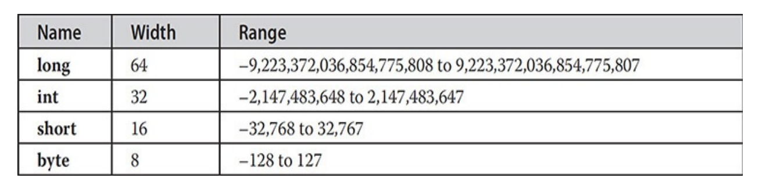
Integers
Java defines four integer types: byte, short, int, and long. All of these are signed, positive and negative values.
Java does not support unsigned values. Java’s designers felt that unsigned integers were unnecessary.

Slide 27
byte
The smallest integer type is byte.
This is a signed 8-bit type that has a range from –128 to 127.
Variables of type byte are especially useful when you’re working with a stream of data from a network or file.
Byte variables are declared by use of the byte keyword.
For example, the following declares two byte variables called b and c:
byte b, c;

Slide 28
short
short is a signed 16-bit type.
It has a range from –32,768 to 32,767.
It is probably the least-used Java type.
Here are some examples of short variable declarations:
short s;
short t;

Slide 29
int
The most commonly used integer type is int.
It is a signed 32-bit type that has a range from –2,147,483,648 to 2,147,483,647.
Variables of type int are commonly employed to control loops and to index arrays.
Although you might think that using a byte or short would be more efficient than using an int in situations in which the larger range of an int is not needed, this may not be the case.
The reason is that when byte and short values are used in an expression, they are promoted to int when the expression is evaluated. (Type promotion is described later in this chapter.)
Therefore, int is often the best choice when an integer is needed.

Slide 30
long
long is a signed 64-bit type and is useful for those occasions where an int type is not large enough to hold the desired value.
The range of a long is quite large. This makes it useful when big, whole numbers are needed.

Slide 31
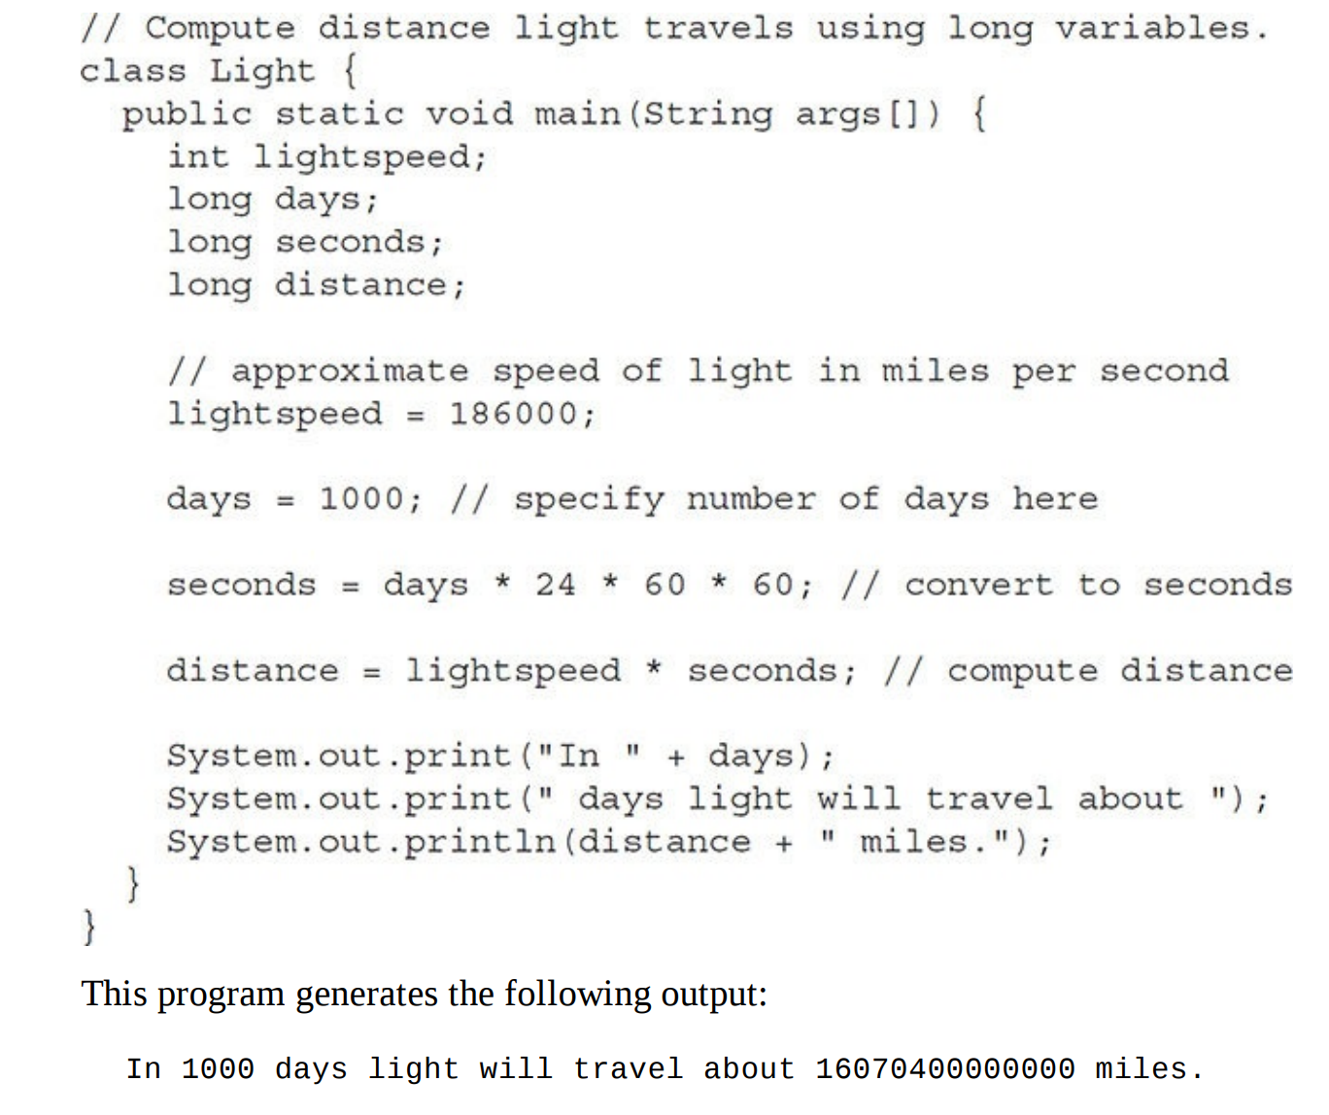
long
For example, here is a program that computes the number of miles that light will travel in a specified number of days:

Slide 32
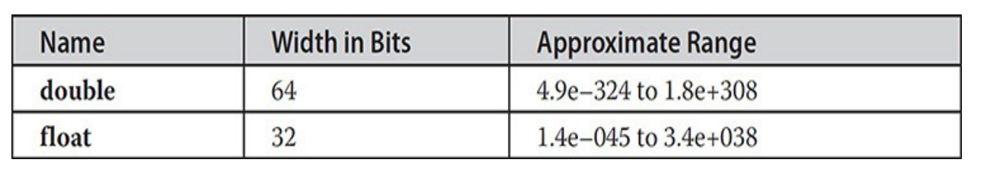
Floating-Point Types
Also known as real numbers.
Used when evaluating expressions that require fractional precision.
For example, calculations such as square root, sine and cosine.
Java implements the standard (IEEE– 754) set of floating-point types and operators.
There are two kinds of floatingpoint types,
float (single-precision) and
double (double-precision),
Their width and ranges are shown here:

Slide 33
float
The type float specifies a single-precision value that uses 32 bits of storage.
Single precision is faster on some processors and takes half as much space as double precision, but will become imprecise when the values are either very large or very small.
Variables of type float are useful when you need a fractional component, but don’t require a large degree of precision.
For example, float can be useful when representing dollars and cents. Here are some example float variable declarations:
float hightemp, lowtemp;

Slide 34
double
Double precision, as denoted by the double keyword, uses 64 bits to store a value.
Double precision is actually faster than single precision on some modern processors that have been optimized for high-speed mathematical calculations.
All math functions, such as sin( ), cos( ), and sqrt( ), return double values.
When you need to maintain accuracy over many iterative calculations, or are manipulating large-valued numbers, double is the best choice.

Slide 35
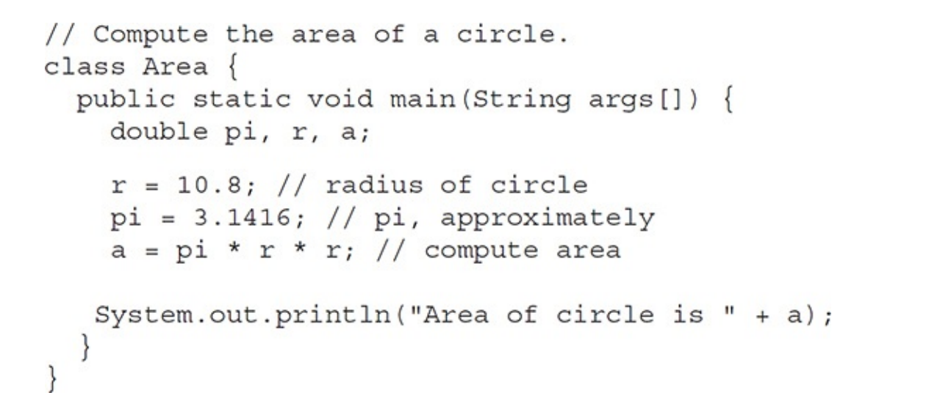
double-example
Here is a short program that uses double variables to compute the area of a circle

Slide 36
Characters
In Java, the data type used to store characters is char.
char in Java is not the same as char in C or C++.
In C/C++, char is 8 bits wide.
Java uses Unicode to represent characters.
Unicode defines a fully international character set that can represent all of the characters found in all human languages.
It is a unification of dozens of character sets, such as Latin, Greek, Arabic, Cyrillic, Hebrew, Katakana, Hangul, and many more.
At the time of Java's creation, Unicode required 16 bits. Thus, in Java char is a 16-bit type.

Slide 37
CharDemo.java
/ Demonstrate char data type.
class CharDemo {
public static void main(String args[]) {
char ch1, ch2;
ch1 = 88; // code for X
ch2 = 'Y';
System.out.print("ch1 and ch2: ");
System.out.println(ch1 + " " + ch2);
}
}
----jGRASP exec: java CharDemo
ch1 and ch2: X Y
----jGRASP: operation complete.

Slide 38
CharDemo2.java
// char variables behave like integers.
class CharDemo2 {
public static void main(String args[]) {
char ch1;
ch1 = 'X';
System.out.println("ch1 contains " + ch1);
ch1++; // increment ch1
System.out.println("ch1 is now " + ch1);
}
}
----jGRASP exec: java CharDemo2
ch1 contains X
ch1 is now Y
----jGRASP: operation complete.

Slide 39
Booleans
Java has a primitive type, called boolean, for logical values.
It can have only one of two possible values, true or false.

Slide 40
BoolTest.java
// Demonstrate boolean values.
class BoolTest {
public static void main(String args[]) {
boolean b;
b = false;
System.out.println("b is " + b);
b = true;
System.out.println("b is " + b);
// a boolean value can control the if statement
if(b)
System.out.println("This is executed.");
b = false;
if(b)
System.out.println("This is not executed.");
// outcome of a relational operator is a boolean value
System.out.println("10 > 9 is " + (10 > 9));
}
}
----jGRASP exec: java BoolTest
b is false
b is true
This is executed.
10 > 9 is true
----jGRASP: operation complete.

Slide 41
Integer Literals
Any whole number value is an integer literal.
Examples are 1, 2, 3, and 42. These are all decimal values, meaning they are describing a base 10 number.
Two other bases that can be used in integer literals are octal (base eight) and hexadecimal (base 16).
Octal values are denoted in Java by a leading zero.
Normal decimal numbers cannot have a leading zero.
octal’s have range from 0 to 7.

Slide 42
Variables
The variable is the basic unit of storage in a Java program.
A variable is defined by the combination of an identifier, a type, and an optional initializer. In addition, all variables have a scope, which defines their visibility, and a lifetime. These elements are examined next
Declaring a Variable
In Java, all variables must be declared before they can be used. The basic form of a variable declaration is shown here:
type identifier [ = value ][, identifier [= value ] …];
Here, type is one of Java’s atomic types, or the name of a class or interface

Slide 43
Variables

Slide 44
The Scope and Lifetime of Variables
So far, all of the variables used have been declared at the start of the main( ) method. However, Java allows variables to be declared within any block. A block defines a scope.
Thus, each time you start a new block, you are creating a new scope. A scope determines what objects are visible to other parts of your program. It also determines the lifetime of those objects.
It is not uncommon to think in terms of two general categories of scopes: global and local.
However, these traditional scopes do not fit well with Java’s strict, object-oriented model.
While it is possible to create what amounts to being a global scope, it is by far the exception, not the rule.
In Java, the two major scopes are those defined by a class and those defined by a method.

Slide 45
The Scope and Lifetime of Variables
The scope defined by a method begins with its opening curly brace. However, if that method has parameters, they too are included within the method’s scope. A method’s scope ends with its closing curly brace. This block of code is called the method body.
As a general rule, variables declared inside a scope are not visible (that is, accessible) to code that is defined outside that scope.
Thus, when you declare a variable within a scope, you are localizing that variable and protecting it from unauthorized access and/or modification. Indeed, the scope rules provide the foundation for encapsulation.
A variable declared within a block is called a local variable.
Scopes can be nested. For example, each time you create a block of code, you are creating a new, nested scope. When this occurs, the outer scope encloses the inner scope. This means that objects declared in the outer scope will be visible to code within the inner scope. However, the reverse is not true. Objects declared within the inner scope will not be visible outside it.

Slide 46
The Scope and Lifetime of Variables

Slide 47
Type Conversion and Casting
1) Assigning a value of one type to a variable of another type is known as Type conversion.
2) In Java, Type conversions will occur in two places :
a. In Assignments
b. In Expressions
3) In Java, Type conversion is classified into two types: a. Automatic / Widening conversion / Implicit conversion (Between compatible types)
b. Casting / Narrowing conversion / Explicit conversion (Between Incompatible types)

Slide 48
Type Conversion and Casting
Automatic Conversions / Widening conversion / Implicit conversion
When one type of data is assigned to another type of variable, an automatic type conversion will take place if the following two conditions are met:
i. The two types are compatible.
ii. The destination type is larger than the source type.
2) For widening conversions, the numeric types, including integer and floating-point types, are compatible with each other.
3) There are no automatic conversions from the numeric types to char or boolean.
4) Java also performs an automatic type conversion when storing a literal integer constant into variables of type byte, short, long, or char.
public class Test
{
public static void main(String[] args)
{
int i = 100;
long L = i; //no explicit type casting required float f = L; //no explicit type casting required char ch = 100; //no explicit type casting required
System.out.println("Int value "+i); System.out.println("Long value "+L); System.out.println("Float value "+f); System.out.println("Char value "+ch);
}
}

Slide 49
Type Conversion and Casting
2. Explicit conversion or Casting or Narrowing conversion
1) To create a conversion between two incompatible types, we must use a cast.
2) A cast is simply an explicit type conversion.
3) The general form of Casting is – (target-type) value
// Demonstrate casting
class Casting {
public static void main(String args[]) { byte b;
int I = 257;
double d = 323.142;
System.out.println("\n Conversion of int to byte."); b = (byte) I;
System.out.println("I and b: " + I + " " + b);
System.out.println("\n Conversion of double to int."); I = (int) d;
System.out.println("d and I :" + d + " " + I);
System.out.println("\n Conversion of double to byte."); b = (byte) d;
System.out.println("d and b: " + d + " " + b); } }

Slide 50
Automatic Type Promotion in Expressions
Java’s Type Promotion Rules
1. All byte, short, and char values are promoted to int.
2. If one operand is a long, the whole expression is promoted to long.
3. If one operand is a float, the entire expression is promoted to float.
4. If any of the operands are double, the result is double.
Example: byte b = 50;
Output:
Compilation Error (because, in expression, byte is promoted to int so, the result also int)
b = b * 2; 36
Example
class Test {
public static void main(String args[]) { byte b = 42;
char c = 'a'; short s = 1024; int i = 50000; float f = 5.67f;
double d = .1234;
double result = (f * b) + (i / c) - (d * s); System.out.println((f * b) + " + " + (i / c) + " - " + (d * s));
System.out.println("result = " + result);
} } Output: 235.2 + 515 - 126.3616 result = 623.8384122070313

Slide 51
Access Modifiers
In Java, access modifiers are keywords that determine the visibility or accessibility of classes, methods, and fields in a class. There are four access modifiers in Java:
Default (Package-private)
public
private
protected

Slide 52
Default-package private access modifier
If no access modifier is specified, it is considered default (also known as package-private).
Members (classes, methods, and fields) with default access are accessible within the same package but not outside of it.
class MyClass {
int myField; // default access
void myMethod() {
// default access
}
}

Slide 53
public- access modifier
The public modifier makes a class, method, or field accessible from any other class.
There are no restrictions on accessing public members.
public class PublicClass {
public int publicField;
public void publicMethod() {
// code here
}
}

Slide 54
private-access modifier
The private modifier makes a member (method or field) accessible only within the same class.
It provides the highest level of encapsulation.
public class MyClass {
private int privateField;
private void privateMethod() {
// code here
}
}

Slide 55
protected-access modifier
The protected modifier allows a member to be accessible within its own package and by subclasses.
It is similar to default access but with the addition that it allows access to subclasses even if they are in a different package.
public class MyBaseClass {
protected int protectedField;
protected void protectedMethod() {
// code here
}} public class MySubClass extends MyBaseClass {
void anotherMethod() {
protectedField = 42; // Accessing protected member from the subclass
} }

Slide 56
Here's a summary:
public: Accessible from anywhere.
protected: Accessible within the same package and by subclasses, even if they are in a different package.
Default (Package-Private): Accessible within the same package.
private: Accessible only within the same class.

Slide 57
Lexical Issues
Java programs are a collection of atomic elements such as whitespace, identifiers, literals, comments, operators, separators, and keywords.
Whitespace
Java is a free-form language. This means that you do not need to follow any special indentation rules. For instance, the Example program could have been written all on one line in Java, whitespace includes a space, tab, newline, or form feed.

Slide 58
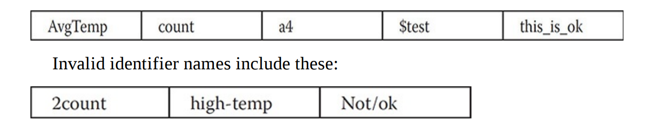
Identifiers
Identifiers are used to name things, such as classes, variables, and methods.
An identifier may be any descriptive sequence of uppercase and lowercase letters, numbers, or the underscore and dollar-sign characters. (The dollar-sign character is not intended for general use.)
They must not begin with a number, lest they be confused with a numeric literal.
Java is case-sensitive, so VALUE is a different identifier than Value. Some examples of valid identifier are

Slide 59
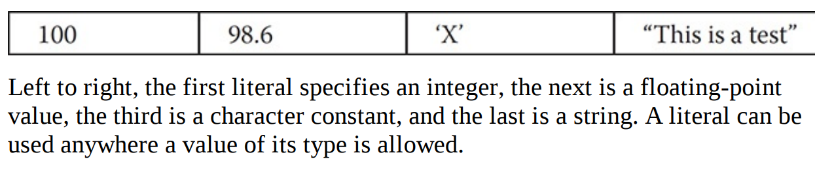
Literals
A constant value in Java is called literal.
For example, here are some literals:

Slide 60
Comments
single-line comment
// comment line
multiline comment
/* here goes the
multi line
comment */
The third type is called a documentation comment.
This type of comment is used to produce an HTML file that documents your program. The documentation comment begins with a /** and ends with a */.

Slide 61
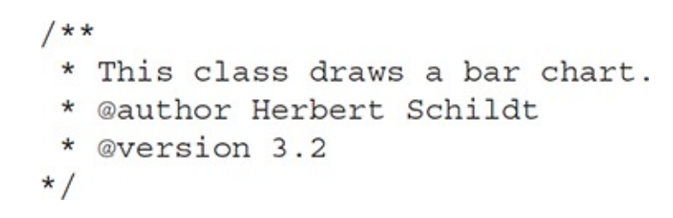
Example of a document comment

Slide 62
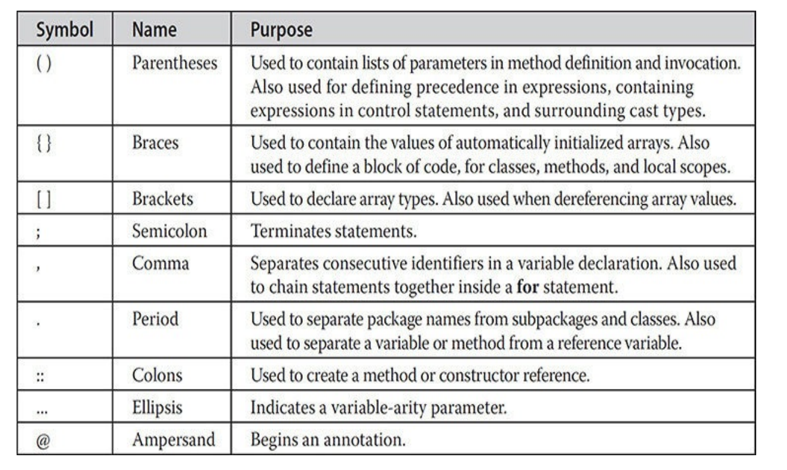
Separators

Slide 63
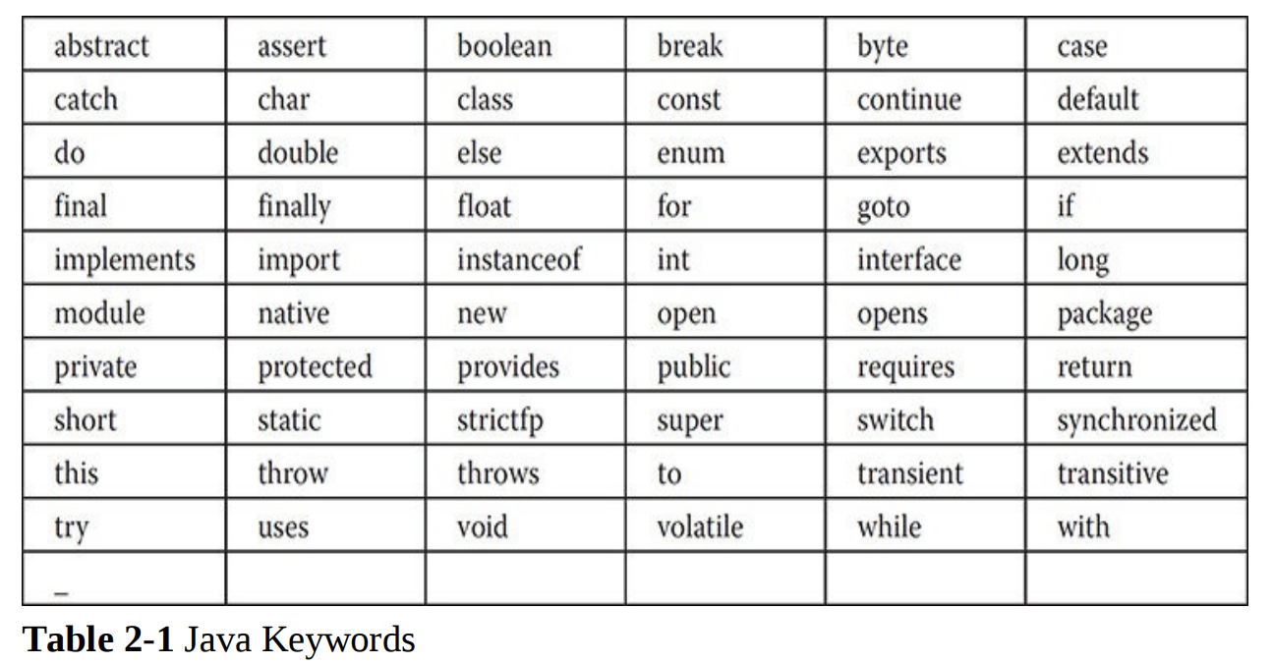
The Java Keywords

Slide 64
The Java Class Libraries
Java’s built-in methods used in the sample programs so far:
println( ) and
print( ).
These methods are available through System.out.System is a class predefined by Java that is automatically included in your programs.
Java environment relies on several built-in class libraries that contain many built-in methods that provide support for such things as I/O, string handling, networking, and graphics.

Slide 65
Arrays
Collection of elements of similar type under one name.
One-Dimensional Arrays:
Declaration
type var-name[ ];
Example: int month_days[];
But this will not allocate memory. To allocate the memory you have to use new keyword.
The general form of new as it applies to one-dimensional arrays appears as follows:
array-var = new type [size];
Ex:- month_days = new int[12];

Slide 66
Example on 1D-arrays
// Demonstrate a one-dimensional array.
class Array {
public static void main(String args[]) {
int month_days[];
month_days = new int[12];
month_days[0] = 31;
month_days[1] = 28;
month_days[2] = 31;
month_days[3] = 30;
month_days[4] = 31;
month_days[5] = 30;

Slide 67
month_days[6] = 31;
month_days[7] = 31;
month_days[8] = 30;
month_days[9] = 31;
month_days[10] = 30;
month_days[11] = 31;
System.out.println("April has " + month_days[3] + " days.");
}
}
----jGRASP exec: java Array
April has 30 days.
----jGRASP: operation complete.

Slide 68
An improved version of the previous program. [No need of new keyword]
// An improved version of the previous program.
class AutoArray {
public static void main(String args[]) {
int month_days[] = { 31, 28, 31, 30, 31, 30, 31, 31, 30, 31,
30, 31 };
System.out.println("April has " + month_days[3] + " days.");
}
}
----jGRASP exec: java AutoArray
April has 30 days.
----jGRASP: operation complete.

Slide 69
Average example using arrays
// Average an array of values.
class Average {
public static void main(String args[]) {
double nums[] = {10.1, 11.2, 12.3, 13.4, 14.5};
double result = 0;
int i;
for(i=0; i<5; i++)
result = result + nums[i];
System.out.println("Average is " + result / 5);
}
}
----jGRASP exec: java Average
Average is 12.299999999999999
----jGRASP: operation complete.

Slide 70
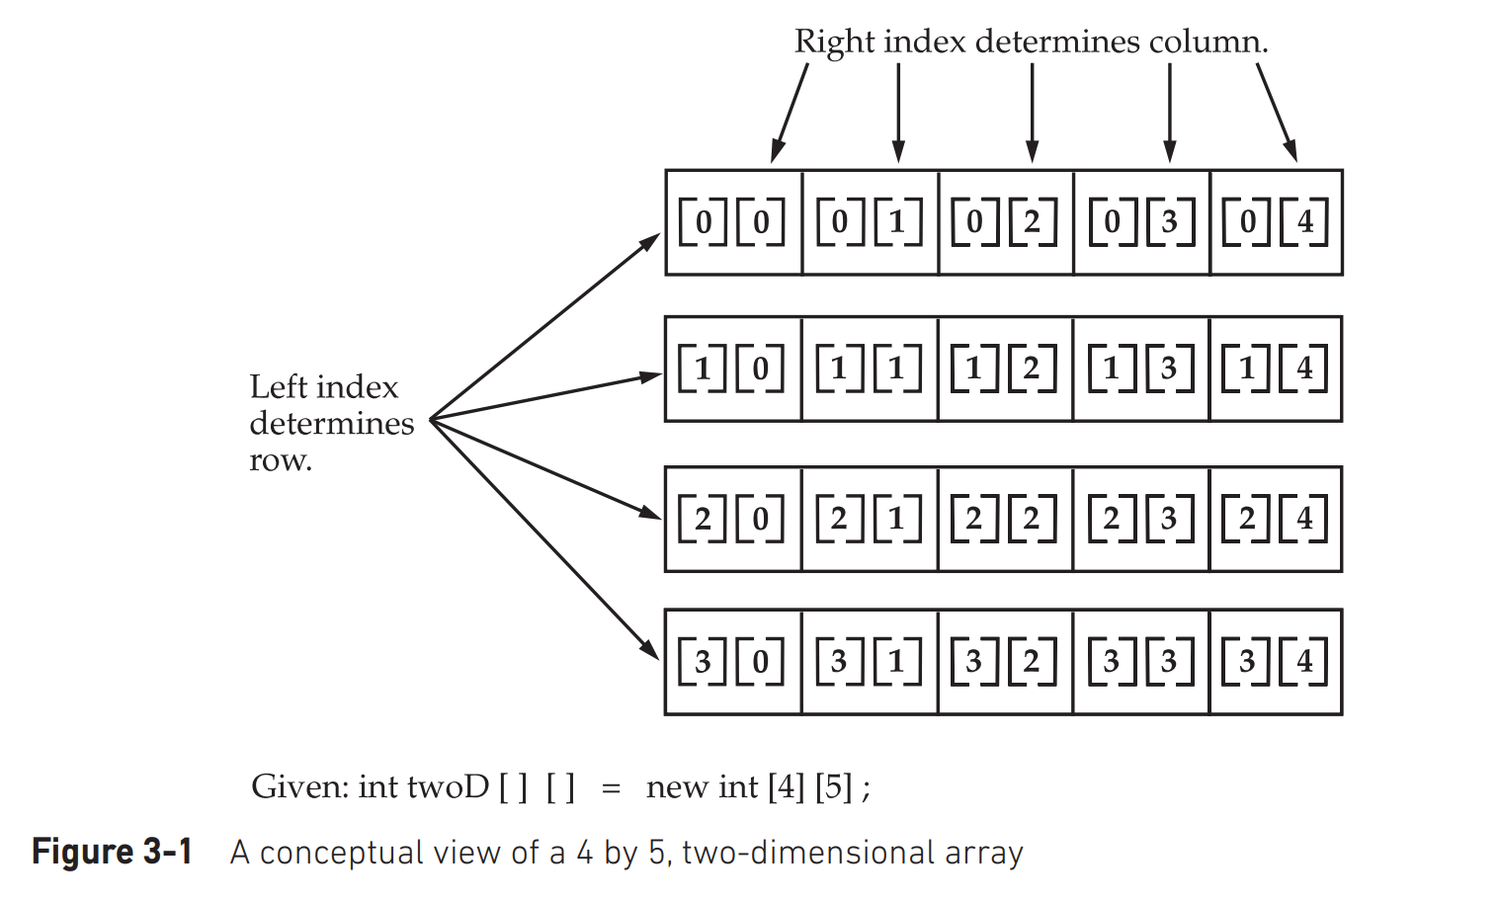
Multidimensional Arrays
The following declares a two dimensional array variable called twoD: int twoD[][] = new int[4][5];
This allocates a 4 by 5 array and assigns it to twoD.
Internally, this matrix is implemented as an array of arrays of int. Conceptually, this array will look like the one shown

Slide 71
Example on TwoDArray
// Demonstrate a two-dimensional array.
class TwoDArray {
public static void main(String args[]) {
int twoD[][]= new int[4][5];
int i, j, k = 0;
for(i=0; i<4; i++)
for(j=0; j<5; j++) {
twoD[i][j] = k;
k++;
}
for(i=0; i<4; i++) {
for(j=0; j<5; j++)
System.out.print(twoD[i][j] + " ");
System.out.println();
}
}
}
----jGRASP exec: java TwoDArray
0 1 2 3 4
5 6 7 8 9
10 11 12 13 14
15 16 17 18 19
----jGRASP: operation complete.

Slide 72
int twoD[][] = new int[4][];
twoD[0] = new int[5];
twoD[1] = new int[5];
twoD[2] = new int[5];
twoD[3] = new int[5];
the above code allocates memory for the first dimension of twoD when it is declared.
It allocates the second dimension manually.

Slide 73
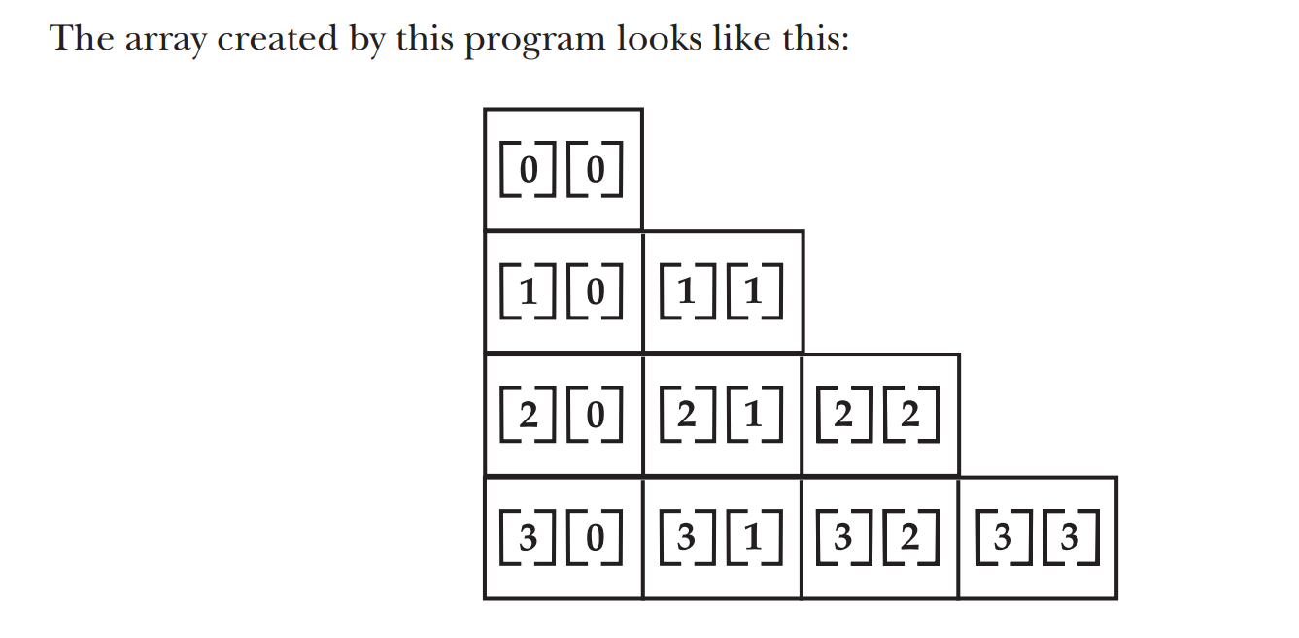
Program creates a two-dimensional array in which the sizes of the second dimension are unequal:
// Manually allocate differing size second dimensions.
class TwoDAgain {
public static void main(String args[]) {
int twoD[][] = new int[4][];
twoD[0] = new int[1];
twoD[1] = new int[2];
twoD[2] = new int[3];
twoD[3] = new int[4];
int i, j, k = 0;
for(i=0; i<4; i++)
for(j=0; j<i+1; j++) {
twoD[i][j] = k;
k++;
for(i=0; i<4; i++) {
for(j=0; j<i+1; j++)
System.out.print(twoD[i][j] + " ");
System.out.println();
}
}
}
This program generates the following output:
0
1 2
3 4 5
6 7 8 9

Slide 74
Direct Initialization of 2D-Array
// Initialize a two-dimensional array.
class Matrix {
public static void main(String args[]) {
double m[][] = {
{ 0*0, 1*0, 2*0, 3*0 },
{ 0*1, 1*1, 2*1, 3*1 },
{ 0*2, 1*2, 2*2, 3*2 },
{ 0*3, 1*3, 2*3, 3*3 }
};
int i, j;
for(i=0; i<4; i++) {
for(j=0; j<4; j++)
System.out.print(m[i][j] + " ");
System.out.println();
}
}
}
When you run this program, you will get the following output:
0.0 0.0 0.0 0.0
0.0 1.0 2.0 3.0
0.0 2.0 4.0 6.0
0.0 3.0 6.0 9.0

Slide 75
3D-array Example on creating a 3 X 4 X 5, three-dimensional array.
// Demonstrate a three-dimensional array.
class ThreeDMatrix {
public static void main(String args[]) {
int threeD[][][] = new int[3][4][5];
int i, j, k;
for(i=0; i<3; i++)
for(j=0; j<4; j++)
for(k=0; k<5; k++)
threeD[i][j][k] = i * j * k;
for(i=0; i<3; i++) {
for(j=0; j<4; j++) {
for(k=0; k<5; k++)
System.out.print(threeD[i][j][k] + " ");
System.out.println();
}
System.out.println();
} }}
This program generates the following output:
0 0 0 0 0
0 0 0 0 0
0 0 0 0 0
0 0 0 0 0
0 0 0 0 0
0 1 2 3 4
0 2 4 6 8
0 3 6 9 12
0 0 0 0 0
0 2 4 6 8
0 4 8 12 16
0 6 12 18 24

Slide 76
Alternative Array Declaration Syntax
type[ ] var-name;
1D-Declaration
int al[] = new int[3]; // both are same
int[] a2 = new int[3];
2D-declaration
char twod1[][] = new char[3][4];
char[][] twod2 = new char[3][4];
int[] nums, nums2, nums3; // create three arrays
int nums[], nums2[], nums3[]; // create three arrays

Slide 77
Operators and Control statements

Slide 78
Outline
Operators: Arithmetic Operators,
The Bitwise Operators
Relational Operators
Boolean Logical Operators
The Assignment Operator
The ? Operator
Operator Precedence
Using Parentheses
Control Statements: Java’s Selection Statements
Iteration Statements
Jump Statements.

Slide 79
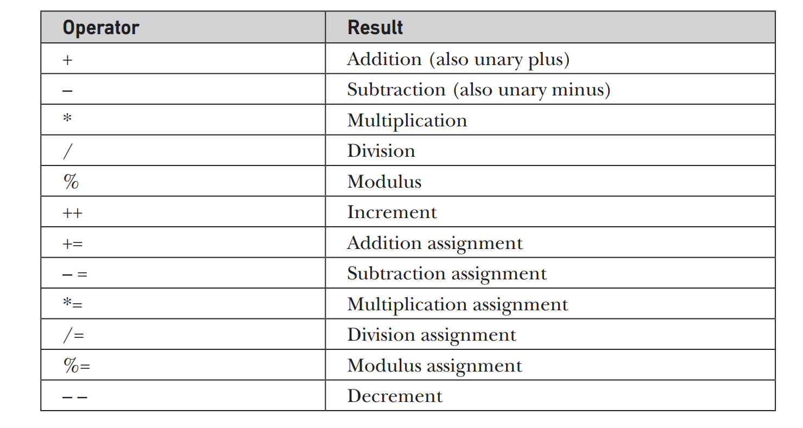
Operators
Arithmetic Operators

Slide 80
The Basic Arithmetic Operators
Integer Arithmetic
a = 2
b = 6
c = 1
d = -1
e = 1
Floating Point Arithmetic
da = 2.0
db = 6.0
dc = 1.5
dd = -0.5
de = 0.5
// Demonstrate the basic arithmetic operators.
class BasicMath {
public static void main(String args[]) {
// arithmetic using integers
System.out.println("Integer Arithmetic");
int a = 1 + 1;
int b = a * 3;
int c = b / 4;
int d = c - a;
int e = -d;
System.out.println("a = " + a);
System.out.println("b = " + b);
System.out.println("c = " + c);
System.out.println("d = " + d);
System.out.println("e = " + e);
// arithmetic using doubles
System.out.println("\nFloating Point Arithmetic");
double da = 1 + 1;
double db = da * 3;
double dc = db / 4;
double dd = dc - a;
double de = -dd;
System.out.println("da = " + da);
System.out.println("db = " + db);
System.out.println("dc = " + dc);
System.out.println("dd = " + dd);
System.out.println("de = " + de);
}
}

Slide 81
The Modulus Operator
The modulus operator, %, returns the remainder of a division operation.
It can be applied to floating-point types as well as integer types.
// Demonstrate the % operator.
class Modulus {
public static void main(String args[]) {
int x = 42;
double y = 42.25;
System.out.println("x mod 10 = " + x % 10);
System.out.println("y mod 10 = " + y % 10);
}
}
When you run this program, you will get the following output:
x mod 10 = 2
y mod 10 = 2.25

Slide 82
Arithmetic Compound Assignment Operators
a = a + 4;
In Java, you can rewrite this statement as shown here:
a += 4;
This version uses the += compound assignment operator.
var = var op expression;
can be rewritten as
var op= expression;

Slide 83
Increment and Decrement
The ++ and the – – are Java’s increment and decrement operators.
The increment operator increases its operand by one. The decrement operator decreases its operand by one.
For example, this statement:
x = x + 1;
can be rewritten like this by use of the increment operator:
x++; ++x;
Similarly, this statement:
x = x - 1;
is equivalent to
x--;

Slide 84
These operators are unique in that they can appear both in postfix form, where they follow the operand as just shown, and prefix form, where they precede the operand is modified. For example:
x = 42;
y = ++x;
In this case, y is set to 43 as you would expect, because the increment occurs before x is assigned to y.
Thus, the line y = ++x; is the equivalent of these two statements:
x = x + 1;
y = x;
However, when written like this,
x = 42;
y = x++;
the value of x is obtained before the increment operator is executed, so the value of y is 42.
Of course, in both cases x is set to 43. Here, the line y = x++; is the equivalent of these two statements:
y = x;
x = x + 1;
Notes:
X=42
Y=++x y=x++
Y=43 y=42
X=43 x=43
*
MITE
84

Slide 85
System.out.println("a = " + a); //a=2
System.out.println("b = " + b); //b=3
System.out.println("c = " + c); //c=4
System.out.println("d = " + d); //d=0
System.out.println("e="+e); //e=1
System.out.println("f="+f);//f=2
System.out.println("G="+G);//G=5
}
}
// Demonstrate ++.
class IncDec {
public static void main(String args[]) {
int a = 1;
int b = 2;
int c;
int d;
c = ++b;
d = a++;
c++;
int e=d--;
int f=--c;
int G=c++ + --f;
Notes:
The output of this program follows:
a = 2
b = 3
c = 4
d = 1
*
MITE
85

Slide 86
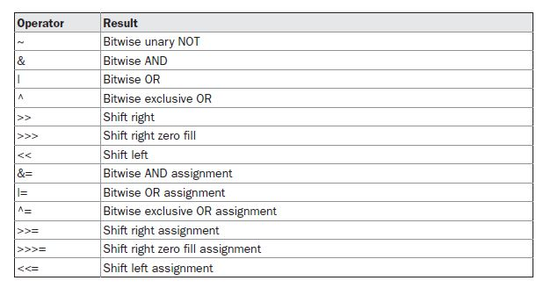
The Bitwise Operators
Java defines several bitwise operators that can be applied to the integer types, long, int, short, char, and byte.
These operators act upon the individual bits of their operands.
Notes:
For
example, the byte value for 42 in binary is 00101010, where each position represents a power
of two, starting with 20 at the rightmost bit. The next bit position to the left would be 21, or 2,
continuing toward the left with 22, or 4, then 8, 16, 32, and so on.
*
MITE
86

Slide 87

The Bitwise Logical Operators
The bitwise logical operators are &, |, ^, and ~.
The bitwise operators are applied to each individual bit within each operand.

Slide 88
// Demonstrate the bitwise logical operators.
class BitLogic {
public static void main(String args[]) {
String binary[] ={
"0000", "0001", "0010", "0011", "0100", "0101", "0110", "0111",
"1000", "1001", "1010", "1011", "1100", "1101", "1110", "1111"
};
int a = 3; // 0 + 2 + 1 or 0011 in binary
int b = 6; // 4 + 2 + 0 or 0110 in binary
int c = a | b;
int d = a & b;
int e = a ^ b;
int f = (~a & b) | (a & ~b);
int i=0X0f;
int g = ~a & 0x0f;
System.out.println(" a = " + binary[a]);//binary[3]=0011
System.out.println(" b = " + binary[b]); //binary[6]=0110
System.out.println(" a|b = " + binary[c]);
System.out.println(" a&b = " + binary[d]);
System.out.println(" a^b = " + binary[e]);
System.out.println("~a&b|a&~b = " + binary[f]);
System.out.println(" ~a = " + binary[g]);
System.out.println(" i = " + binary[i]);
}
}
Notes:
a = 0011
b = 0110
a|b = 0111
a&b = 0010
a^b = 0101
~a&b|a&~b = 0101
~a = 1100
0 0 1 1 1100
0 1 1 0
0 0 1 0
*
MITE
88

Slide 89
The Left Shift
The left shift operator, <<, shifts all of the bits in a value to the left a specified number of times.
It has this general form:
syntax: value << num
Here, num specifies the number of positions to left-shift the value in value.
The << moves all of the bits in the specified value to the left by the number of bit positions specified by num.
For each shift left, the high-order bit is shifted out (and lost), and a zero is brought in on the right.
This means that when a left shift is applied to an int operand, bits are lost
once they are shifted past bit position 31. If the operand is a long, then bits are lost after bit position 63.
Notes:
*
MITE
89

Slide 90
// Left shifting a byte value.
class ByteShift {
public static void main(String args[]) {
byte a = 64, b;
int i;
i = a << 2;
b = (byte) (a << 2);
System.out.println("Original value of a: " + a);
System.out.println("i and b: " + i + " " + b);
}
}
Notes:
The output generated by this program is shown here:
Original value of a: 64
i and b: 256 0
*
MITE
90

Slide 91
The Right Shif
The right shift operator, >>, shifts all of the bits in a value to the right a specified number of times.
Its general form is shown here:
Syntax: value >> num
Here, num specifies the number of positions to right-shift the value in value.
The >> moves all of the bits in the specified value to the right the number of bit positions specified by num.
The following code fragment shifts the value 32 to the right by two positions, resulting in a being set to 8:
int a = 32;
a = a >> 2;

Slide 92
Right Shift Example
// Left shifting a byte value.
class ByteShiftRight {
public static void main(String args[]) {
byte a = 64, b;
int i;
i = a >> 2;
b = (byte) (a >> 2);
System.out.println("Original value of a: " + a);
System.out.println("i and b: " + i + " " + b);
}
}

Slide 93
program demonstrates the bitwise operators
public class Test {
public static void main(String args[]) {
int a = 60; /* 60 = 0011 1100 */
int b = 13; /* 13 = 0000 1101 */
int c = 0; c = a & b; /* 12 = 0000 1100 */
c = a << 2; /* 240 = 1111 0000 */
System.out.println("a << 2 = " + c );
c = a >> 2; /* 15 = 1111 */
System.out.println("a >> 2 = " + c );
c = a >>> 2; /* 15 = 0000 1111 */
System.out.println("a >>> 2 = " + c );
}
}

Slide 94
Bitwise Operator Compound Assignments
All of the binary bitwise operators have a compound form similar to that of the algebraic operators, which combines the assignment with the bitwise operation.
For example, the following two statements, which shift the value in a right by four bits, are equivalent:
a = a >> 4;
a >>= 4;
Likewise, the following two statements, which result in a being assigned the bitwise
expression a OR b, are equivalent:
a = a | b;
a |= b;

Slide 95
program creates a few integer variables and then uses compound bitwise operator assignments to manipulate the variables:
class OpBitEquals {
public static void main(String args[]) {
int a = 1;
int b = 2;
int c = 3;
a |= 4;
b >>= 1;
c <<= 1;
a ^= c;
System.out.println("a = " + a);
System.out.println("b = " + b);
System.out.println("c = " + c);
}
}
Notes:
The output of this program is shown here:
a = 3
b = 1
c = 6
*
MITE
95

Slide 96
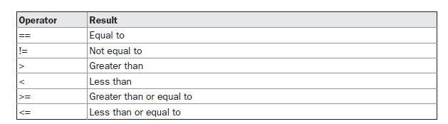
THE RELATIONAL OPERATORS
The relational operators determine the relationship that one operand has to the other.
Specifically, they determine equality and ordering. The relational operators are shown here: The outcome of these operations is a boolean value. The relational operators are most frequently used in the expressions that control the if statement and the various loop statements.
Notes:
The outcome of these operations is a boolean value. The relational operators are most
frequently used in the expressions that control the if statement and the various loop statements.
*
MITE
96

Slide 97
public class Test {
public static void main(String args[])
{
int a = 10;
int b = 20;
System.out.println("a == b = " + (a == b) );
System.out.println("a != b = " + (a != b) );
System.out.println("a > b = " + (a > b) );
System.out.println("a < b = " + (a < b) );
System.out.println("b >= a = " + (b >= a) );
System.out.println("b <= a = " + (b <= a) );
}
}
Notes:
This would produce the following result: a == b = false
a != b = true
a > b = false
a < b = true
b >= a = true
b <= a = false
*
MITE
97

Slide 98
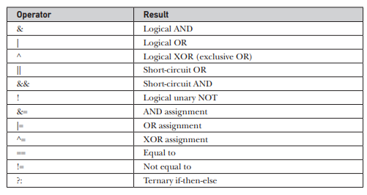
Boolean Logical Operators

Slide 99
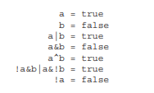
Example
// Demonstrate the boolean logical operators.
class BoolLogic {
public static void main(String args[]) {
boolean a = true;
boolean b = false;
boolean c = a | b;
boolean d = a & b;
boolean e = a ^ b;
boolean f = (!a & b) | (a & !b);
boolean g = !a;
System.out.println(" a = " + a);
System.out.println(" b = " + b);
System.out.println(" a|b = " + c);
System.out.println(" a&b = " + d);
System.out.println(" a^b = " + e);
System.out.println("!a&b|a&!b = " + f);
System.out.println(" !a = " + g);
}
}

Slide 100
The Assignment Operator
The assignment operator is the single equal sign, =.
The assignment operator works in Java much as it does in any other computer language. It has this general form:
var = expression;
Here, the type of var must be compatible with the type of expression.
It allows you to create a chain of assignments.
For example, consider this fragment:
int x, y, z;
x = y = z = 100; // set x, y, and z to 100

Slide 101
The ? Operator
Java includes a special ternary (three-way) operator that can replace certain types of if-then else statements. This operator is the ?.
The ? has this general form:
expression1 ? expression2 : expression3;
ratio = (denom == 0) ? 0 : num / denom;

Slide 102
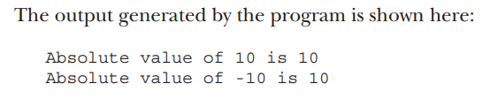
Example
// Demonstrate ?.
class Ternary {
public static void main(String args[]) {
int i, k;
i = 10;
k = i < 0 ? -i : i; // get absolute value of i
System.out.print("Absolute value of ");
System.out.println(i + " is " + k);
i = -10;
k = i < 0 ? -i : i; // get absolute value of i
System.out.print("Absolute value of ");
System.out.println(i + " is " + k);
}
}

Slide 103
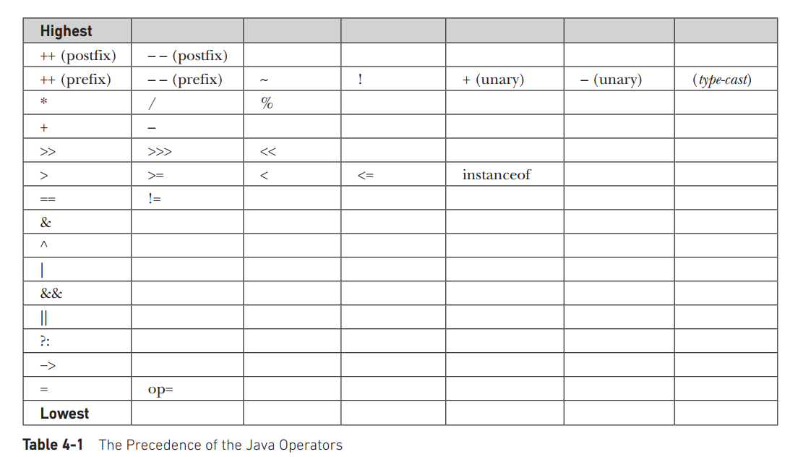
Operator Precedence
Table shows the order of precedence for Java operators, from highest to lowest. Operators in the same row are equal in precedence.

Slide 104
Examples
For example, consider the following expression:
a >> b + 3
This expression first adds 3 to b and then shifts a right by that result. That is, this expression can be rewritten using redundant parentheses like this:
a >> (b + 3)
However, if you want to first shift a right by b positions and then add 3 to that result, you will need to parenthesize the expression like this:
(a >> b) + 3

Slide 105
In addition to altering the normal precedence of an operator, parentheses can sometimes be used to help clarify the meaning of an expression.
For anyone reading your code, a complicated expression can be difficult to understand.
For example, which of the following expressions is easier to read?
a | 4 + c >> b & 7
(a | (((4 + c) >> b) & 7)) // This is easier to read and gives clarity

Slide 106
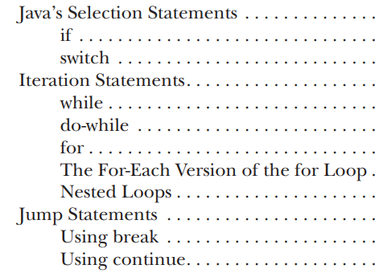
Control Statements
Outline:

Slide 107
if Statement
It can be used to route program execution through two different paths. Here is the general form of the if statement:
if (condition) statement1;
else statement2;
int a, b;
//...
if(a < b) a = 0;
else b = 0;

Slide 108
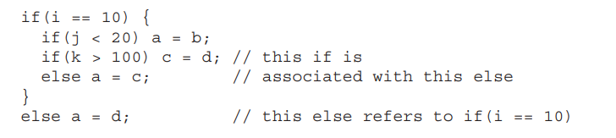
Nested ifs
A nested if is an if statement that is the target of another if or else. Nested ifs are very common in programming.

Slide 109
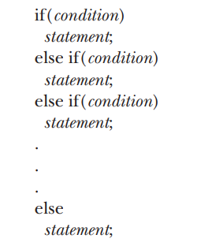

The if-else-if Ladder
// Demonstrate if-else-if statements.
class IfElse {
public static void main(String args[]) {
int month = 4; // April
String season;
if(month == 12 || month == 1 || month == 2)
season = "Winter";
else if(month == 3 || month == 4 || month == 5)
season = "Spring";
else if(month == 6 || month == 7 || month == 8)
season = "Summer";
else if(month == 9 || month == 10 || month == 11)
season = "Autumn";
else
season = "Bogus Month";
System.out.println("April is in the " + season + ".");
}
}

Slide 110
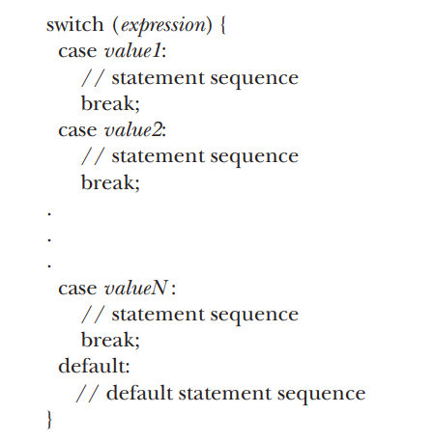
switch
The switch statement is Java’s multiway branch statement. It provides an easy way to dispatch execution to different parts of your code based on the value of an expression.
A better alternative than a large series of if-else-if statements. Here is the general form of a switch statement:

Slide 111
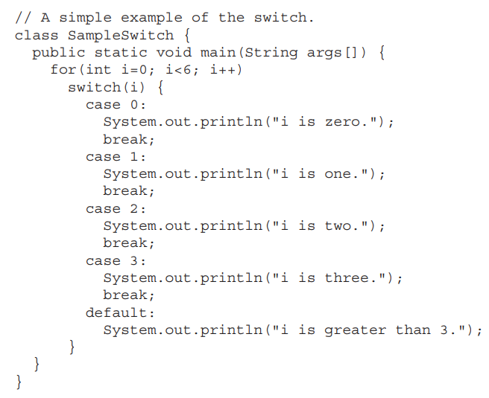
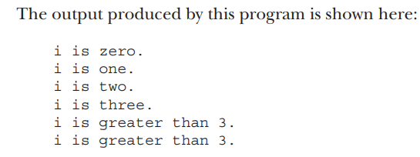
Example

Slide 112
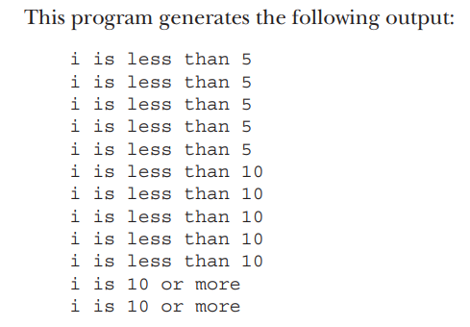
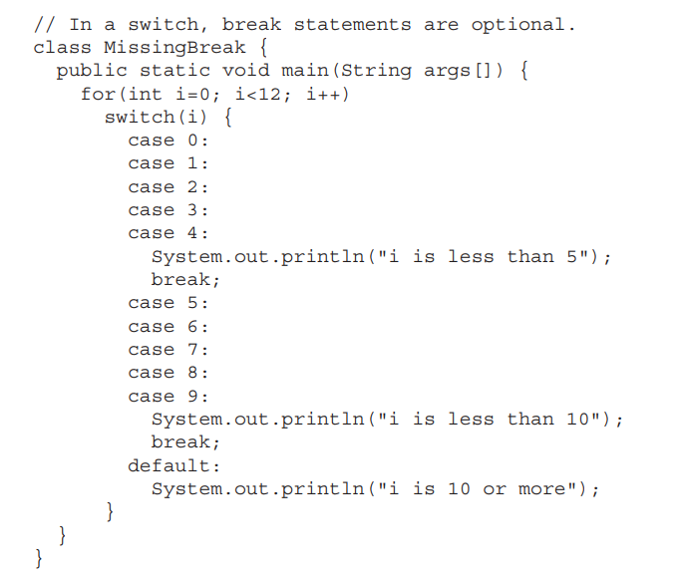
Example on missing break

Slide 113
An improved version of the season program using switch.
case 6:
case 7:
case 8:
season = "Summer";
break;
case 9:
case 10:
case 11:
season = "Autumn";
break;
default:
season = "Bogus Month";
}
System.out.println("April is in the " + season + ".");
}
}
class Switch {
public static void main(String args[]) {
int month = 4;
String season;
switch (month) {
case 12:
case 1:
case 2:
season = "Winter";
break;
case 3:
case 4:
case 5:
season = "Spring";
break;

Slide 114
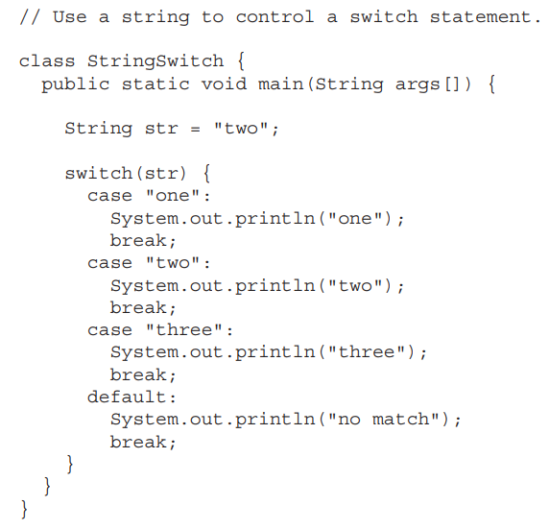
Using Strings to control Switch
beginning with JDK 7, you can use a string to control a switch statement.

Slide 115
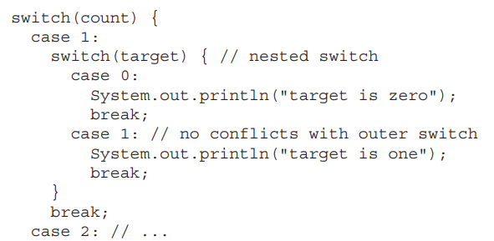
Nested switch Statements
Switch inside another switch is nested switch statement.

Slide 116
Three important features of the switch statement to note:
• The switch differs from the if stmt, switch can only test for equality, whereas if stmt can evaluate any type of Boolean expression. That is, the switch looks only for a match between the value of the expression and one of its case constants.
• No two case constants in the same switch can have identical values. Of course, a switch statement and an enclosing outer switch can have case constants in common.
• A switch statement is usually more efficient than a set of nested if stmts

Slide 117
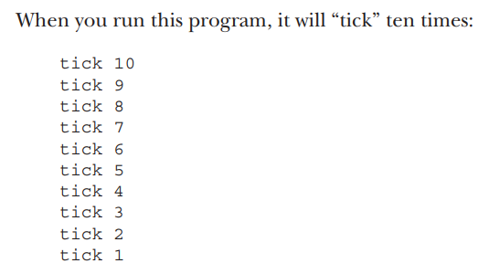
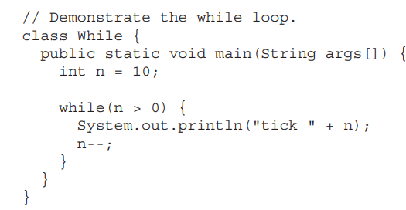
Iteration Statements
while loop: (Entry Controlled)
while(condition) {
// body of loop
}

Slide 118
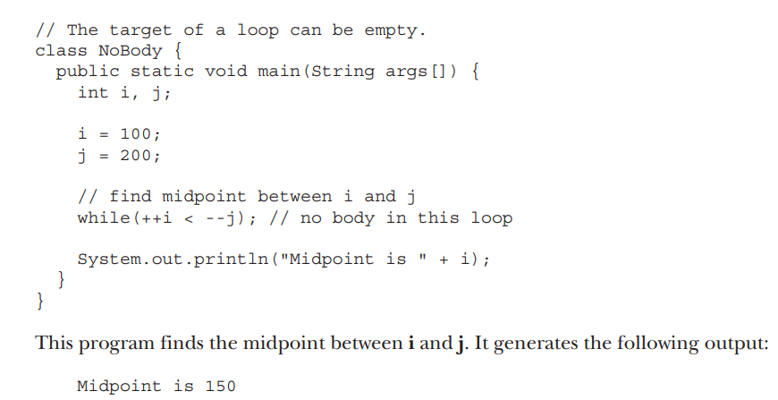
Body of the while loop can be empty

Slide 119

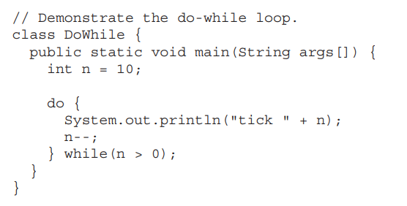
do-while loop
Equivalent and Efficient Code
//Exit Controlled
do {
// body of loop
} while (condition);
Output: 10
9
8
7
6
5
4
3
2
1

Slide 120
for loop
Before JDK5 there was only one for loop (traditional for loop).
Starting from JDK5 there is one more for loop added (for-each version).
Here is the general form of the traditional for statement:
for(initialization; condition; iteration) {
// body
}

Slide 121
Example on traditional for
// Demonstrate the for loop.
class ForTick {
public static void main(String args[]) {
int n;
for(n=10; n>0; n--)
System.out.println("tick " + n); } }

Slide 122
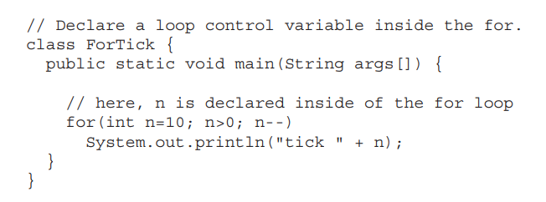
Declaring Loop Control Variables Inside the for Loop

Slide 123
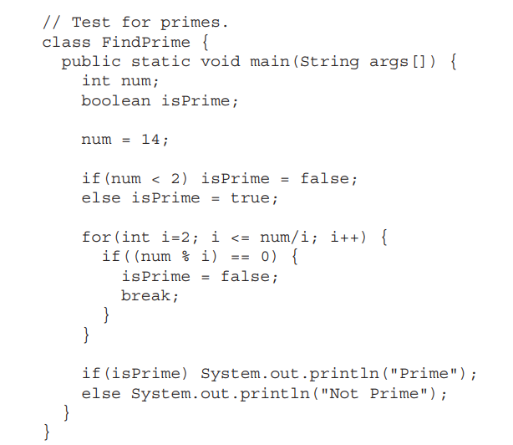
FindPrime example using traditional for

Slide 124
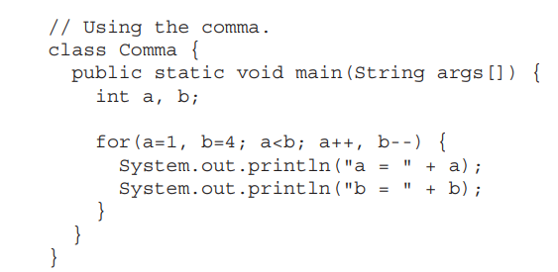
Using the Comma in for loop

Slide 125
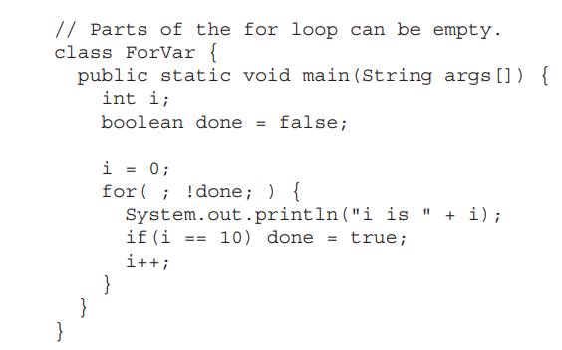
Some for Loop Variations

Slide 126
The For-Each Version of the for Loop
Languages, such as C#, implements a for-each loop by using the keyword foreach
Java adds the for-each capability by enhancing the for statement.
The advantage of this approach is that no new keyword is required, and
no preexisting code is broken.
The for-each style of for is also referred to as the enhanced for loop.

Slide 127
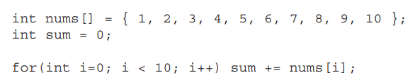
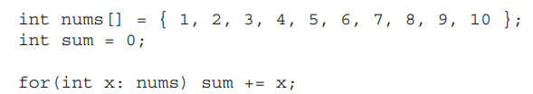
The general form of the for-each version of the for is shown here:
for(type itr-var : collection) statement-block
Using tradition for loop
Using for-each version

Slide 128
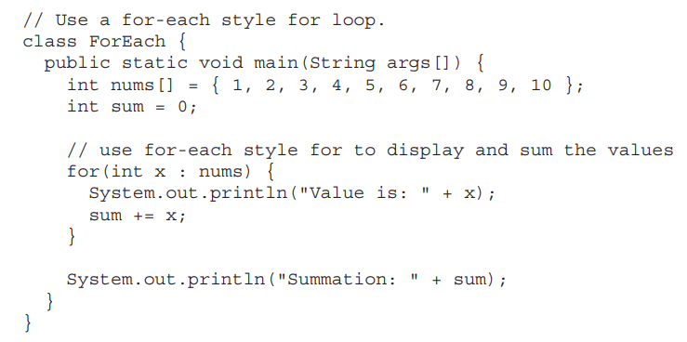
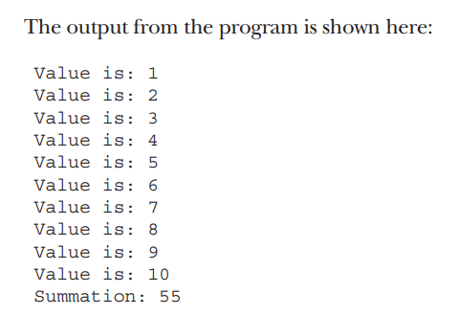
Example

Slide 129
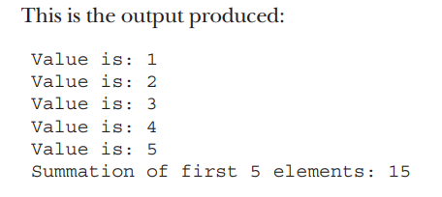
Use break with a for-each style for.
class ForEach2 {
public static void main(String args[]) {
int sum = 0;
int nums[] = { 1, 2, 3, 4, 5, 6, 7, 8, 9, 10 };
// use for to display and sum the values
for(int x : nums) {
System.out.println("Value is: " + x);
sum += x;
if(x == 5) break; // stop the loop when 5 is obtained
}
System.out.println("Summation of first 5 elements: " + sum);
}
}

Slide 130
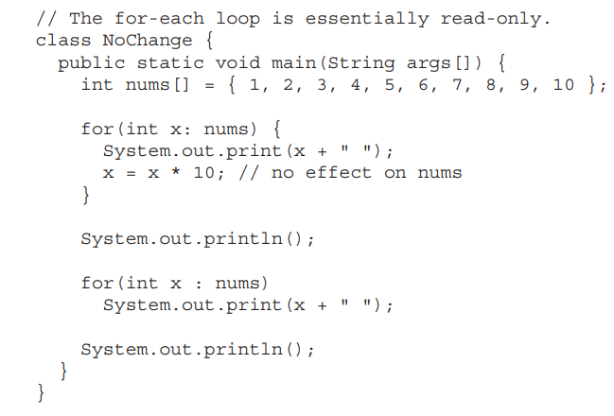
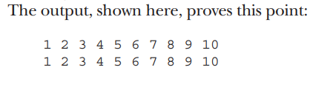
The for-each loop is essentially read-only

Slide 131
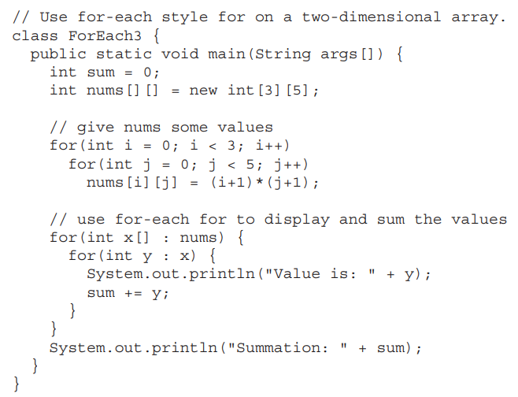
Use for-each style for on a two-dimensional array.
The output from this program is shown here:
Value is: 1
Value is: 2
Value is: 3
Value is: 4
Value is: 5
Value is: 2
Value is: 4
Value is: 6
Value is: 8
Value is: 10
Value is: 3
Value is: 6
Value is: 9
Value is: 12
Value is: 15
Summation: 90

Slide 132
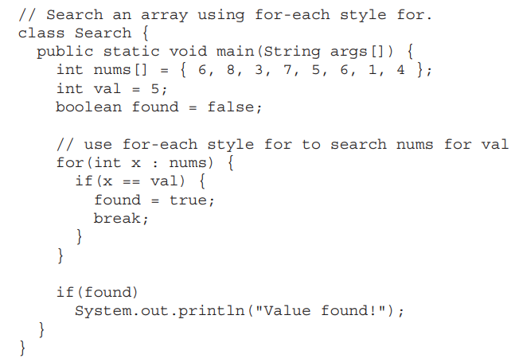
Search an array using for-each style for.

Slide 133
Jump Statements
Java supports three jump statements:
break,
continue, and
return.
These statements transfer control to another part of your program.

Slide 134
Uses of break in java
The break statement has three uses.
First, as you have seen, it terminates a statement sequence in a switch statement.
Second, it can be used to exit a loop.
Third, it can be used as a “civilized” form of goto.

Slide 135
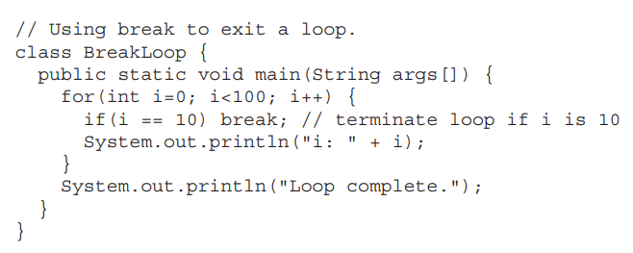
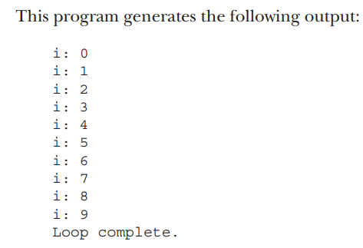
Using break to Exit a Loop

Slide 136

Using break to exit a while loop.

Slide 137


Using break with nested loops.

Slide 138
Using break as a Form of Goto
label general form:
label:{
}
using break to jump out of the label general form
break label;

Slide 139


Example
The break statement causes execution to jump forward, past the end of the block labeled second, skipping the two println( ) statements.

Slide 140

breaking out of the nest loops using label and break
// Using break to exit from nested loops
class BreakLoop4 {
public static void main(String args[]) {
outer: for(int i=0; i<3; i++) {
System.out.print("Pass " + i + ": ");
for(int j=0; j<100; j++) {
if(j == 10) break outer; // exit both loops
System.out.print(j + " ");
}
System.out.println("This will not print");
}
System.out.println("Loops complete.");
}
}

Slide 141

Example on error
Cannot break to any label which is not defined for an enclosing block.
Program is invalid and will not compile, Since the loop labeled one does not enclose the break statement, it is not possible to transfer control out of that block.

Slide 142

Using continue
Continue is used to skip the current loop iteration and get into the next loop iteration.
Example:
// Demonstrate continue.
class Continue {
public static void main(String args[]) {
for(int i=0; i<10; i++) {
System.out.print(i + " ");
if (i%2 == 0) continue;
System.out.println("");
}
}
}

Slide 143


Continue and label
continue may specify a label to describe which enclosing loop to continue.
Example program that uses continue to print a triangular multiplication table for 0 through 9:

Slide 144

return stmt
The return statement is used to explicitly return from a method.
That is, it causes program control to transfer back to the caller of the method.

Slide 145


Nested Loops

Slide 146
Introducing Classes
The class is at the core of Java. It is the logical construct upon which the entire Java language is built because it defines the shape and nature of an object.
As such, the class forms the basis for object-oriented programming in Java
A class is declared by use of the class keyword. A class is a template for an object, and an object is an instance of a class.
The data, or variables, defined within a class are called instance variables. The code is contained within methods. Collectively, the methods and variables defined within a class are called members of the class. In most classes, the instance variables are acted upon and accessed by the methods defined for that class.

Slide 147


Slide 148

A Simple Class
To actually create a Box object, you will use a statement like the following:
Box mybox = new Box(); // create a Box object called mybox
mybox.width = 100;
This statement tells the compiler to assign the copy of width that is contained within the mybox object the value of 100

Slide 149


Slide 150

Declaring Objects
In the preceding sample programs, a line similar to the following is used to declare an object of type Box:
Box mybox = new Box();
This statement combines the two steps just described. It can be rewritten like this to show each step more clearly:
Box mybox; // declare reference to object mybox = new Box(); // allocate a Box object

Slide 151

Assigning Object Reference Variables
Box b1 = new Box(); Box b2 = b1;
Box b1 = new Box(); Box b2 = b1;
// ...
b1 = null;

Slide 152


Slide 153


Slide 154
Constructors
A constructor initializes an object immediately upon creation. It has the same name as the class in which it resides and is syntactically similar to a method.
Once defined, the constructor is automatically called when the object is created, before the new operator completes.
Constructors look a little strange because they have no return type, not even void. This is because the implicit return type of a class’ constructor is the class type itself.
It is the constructor’s job to initialize the internal state of an object so that the code creating an instance will have a fully initialized, usable object immediately.

Slide 155


Slide 156
Before moving on, let’s re-examine the new operator. As you know, when you allocate an object, you use the following general form:
class-var = new classname ( );
Now you can understand why the parentheses are needed after the class name. What is actually happening is that the constructor for the class is being called. Thus, in the line
Box mybox1 = new Box();
new Box( ) is calling the Box( ) constructor. When you do not explicitly define a
constructor for a class, then Java creates a default constructor for the class.

Slide 157
Parameterized Constructors
While the Box( ) constructor in the preceding example does initialize a Box object, it is not very useful—all boxes have the same dimensions. What is needed is a way to construct Box objects of various dimensions. The easy solution is to add parameters to the constructor.
Box defines a parameterized constructor that sets the dimensions of a box as specified by those parameters.

Slide 158


Slide 159

The this Keyword
To allow this, Java defines the this keyword. this can be used inside any method to refer to the current object. That is, this is always a reference to the object on which the method was invoked. You can use this anywhere a reference to an object of the current class’ type is permitted.
To better understand what this refers to, consider the following version of Box( ):

Slide 160
Garbage Collection
Since objects are dynamically allocated by using the new operator, you might be wondering how such objects are destroyed and their memory released for later reallocation. In some languages, such as traditional C++, dynamically allocated objects must be manually released by use of a delete operator. Java takes a different approach; it handles deallocation for you automatically. The technique that accomplishes this is called garbage collection. It works like this: when no references to an object exist, that object is assumed to be no longer needed, and the memory occupied by the object can be reclaimed. There is no need to explicitly destroy objects.

Slide 161
Static vs. Non static Members
Static variables
class Student
{ int rollno; String name; String college="ITS"; }
Suppose there are 500 students in my college, now all instance data members will get memory each time when the object is created. All students have its unique rollno and name, so instance data member is good in such case. Here, "college" refers to the common property of all objects. If we make it static, this field will get the memory only once.

Slide 162
class Student{
int rollno;//instance variable
String name;
static String college ="ITS";//static variable
//constructor
Student(int r, String n){
rollno = r;
name = n;
}
//method to display the values
void display (){System.out.println(rollno+" "+name+" "+college);}
}
Output:
111 Karan ITS
222 Aryan ITS

Slide 163
Static methods:
If we apply static keyword with any method, it is known as static method.
• A static method belongs to the class rather than the object of a class.
• A static method can be invoked without the need for creating an instance of a class.
• A static method can access static data member and can change the value of it.
Java program to call a static method

Slide 164
class Test {
// static method
public static int sum(int a, int b)
{
return a + b;
}
}
class Main {
public static void main(String[] args)
{ int n = 3, m = 6;
// call the static method
int s = Test.sum(n, m);
System.out.print("sum is = " + s);
}} Output: sum is = 9

